Slide 1
IBM HR Analysis

Slide 2
Project analysis slide 5
IBM HR Analysis
Overview
Employees are the backbone of any organization. Its performance is heavily based on the quality of the employees and retaining them. With employee attrition, organizations are faced with several challenges:
1. Expensive in terms of both money and time to train new employees
2. Loss of experienced employees
3. Impact on productivity
4. Impact on profit
This dataset is from IBM HR Analytics Employee Attrition & Performance. It has 35 features describing each employee’s background and characteristics; and labelled with whether they are still in the company or whether they have gone to work somewhere else. Exploratory data analysis can help to understand and determine how these factors relate to workforce attrition

Slide 3
Project analysis slide 3
Data Tables
General Data
Describes the employee data & skills
-ID -Stock Option Level
-Age -Total Working Years
-Business Travel -Training Time Last Year
-Department -Years at Company
-Distance from home
-Education -Years since promotion
-Education Field -Years with last manager
-Gender
-Job Level -Attrition (target)
-Job Role
-Marital Status
-Monthly Income
-Num Companies Worked
-Over 18
-Percent Salary Hike
-Stanadard Hours
Employees Survey
Describes employee feedback on company.
-Job Satisfaction
-Environment Satisfaction
-Work Life Balance
Managers Survey
Describes managers feedback on employees.
-Job Involvement
-Performance Rating

Slide 4
Project analysis slide 2
IBM HR Analysis
Total percentage of quitted employees is 16%, Let’s go through this analysis story to know why?
What are employees overall
feedback about the company?
What are managers overall
Feedback about the employees?
Business
Questions
What factors are contributing
more to employee attrition?
What type of measures should the company take in order to retain
their employees?
What are main business key
Insights found in data?
What considerations company should take
For developing?

Slide 5
Project analysis slide 5
IBM HR Analysis
At first, we keen on analyzing company surveys to check if there is any significant dropdown that is main reason for attrition, and company should observe and enhance.
I - Employees Survey
We checked the percentage of employees gives every rank in survey for the 3 aspects:
-Job Satisfaction
-Environment Satisfaction
-Work Life Balance Satisfaction
Ranks are categorized as:
A (Excellent) B (Good) C(Fair) D (Bad)

Slide 6
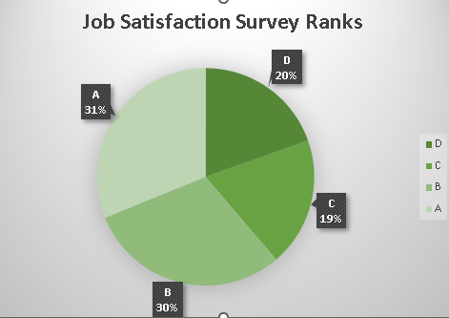
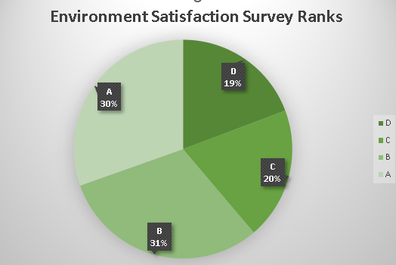
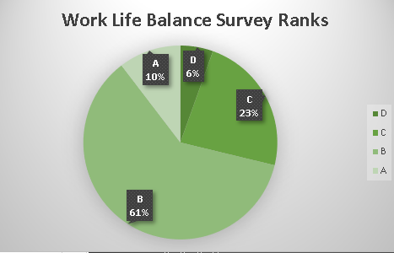
Project analysis slide 5
IBM HR Analysis

Slide 7
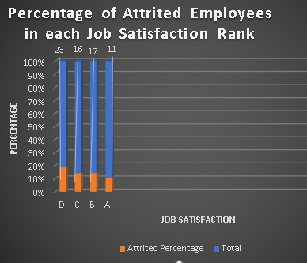
Project analysis slide 5
IBM HR Analysis
Then, It was important to check in every rank in every aspect what is percentage of people actually quit, to know more whether their opinion in the survey affects their personal quit decisions.
Job Satisfaction
Observation:
Observed that employees giving less ranks are
probably more exposed to quit than those giving
higher ranks.

Slide 8
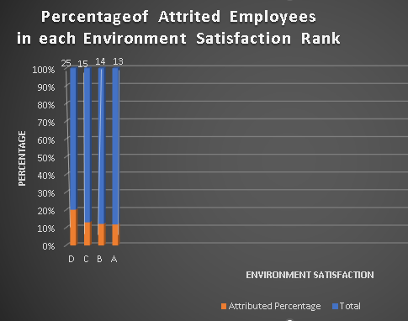
Project analysis slide 5
IBM HR Analysis
2) Environment Satisfaction
Observation:
Observed that employees giving less ranks are
probably more exposed to quit than those giving
higher ranks.

Slide 9
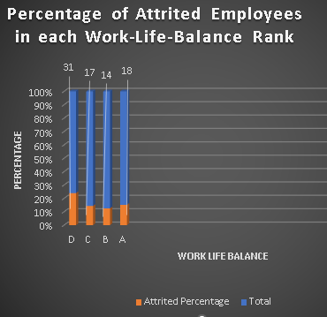
Project analysis slide 5
IBM HR Analysis
  3) Work Life Balance Satisfaction
Observation:
Observed that percentage of employees quit while gave
highest and lowest ranks are more than those who giving
middle ranks
The higher percentage goes to who gave lowest rank
and can’t achieve work lif e balance.

Slide 10
Project analysis slide 5
IBM HR Analysis
I – Managers Survey
We checked the percentage of employees ranked by their managers in every rank in 2 main aspects.
-Job Involvement
-Performance Rating
Ranks are categorized as:
A (Excellent) B (Good) C(Fair) D (Bad)

Slide 11
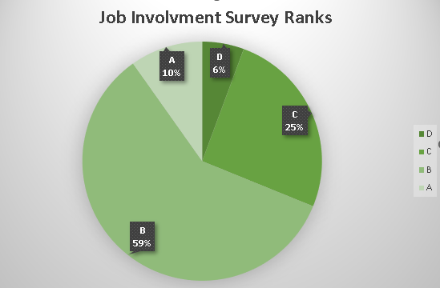
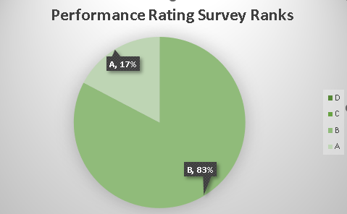
Project analysis slide 5
IBM HR Analysis
Observed that almost 85% of customers are moderate job
Involved while just around 15% are very low or very high
Job involved.
Observed that there’s no employees got low ranks (D & C) and all employees got high ranks (A & B)
Which gives us an indicator that managers are well satisfied from their employees performance..

Slide 12
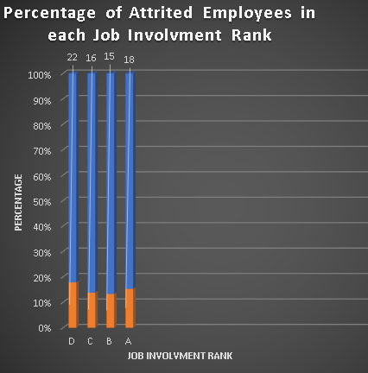
Project analysis slide 5
IBM HR Analysis
Then, It was important to check in every rank in every aspect what is percentage of people actually quit, to know more whether their managers evaluation in the survey and their skills rate affects their personal quit decisions.
Job Involvement
Observation:
Observed percentage differs slightly between different ranks,
with higher percentage value for both most and least job
involved employees.

Slide 13
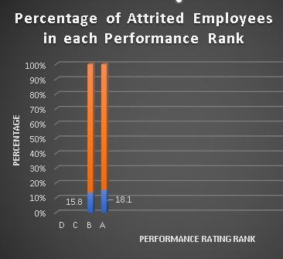
Project analysis slide 5
IBM HR Analysis
2) Performance Rating
Observation:
Observed that employees with higher performance are more
likely to quit.
which gives us an indicator that they may quit due to seeking
another job that satisfies their skills
Company may work on giving opportunities and promotions
for highely performance employees to keep them.

Slide 14
Project analysis slide 5
IBM HR Analysis
After analyzing both employees survey and managers survey, there’s no significant observed insight related to company or managers relationships with employees found that causes the employees to quit so can be handled and worked on.
So further analysis is needed, It’s time to analyze employees related data that includes all the data saved for each employee (education , job , skills , personal life , ….etc) related info to find the reasons behind employees attrition.
Next, one to one relationship between every employee property and attrition is analyzed.

Slide 15
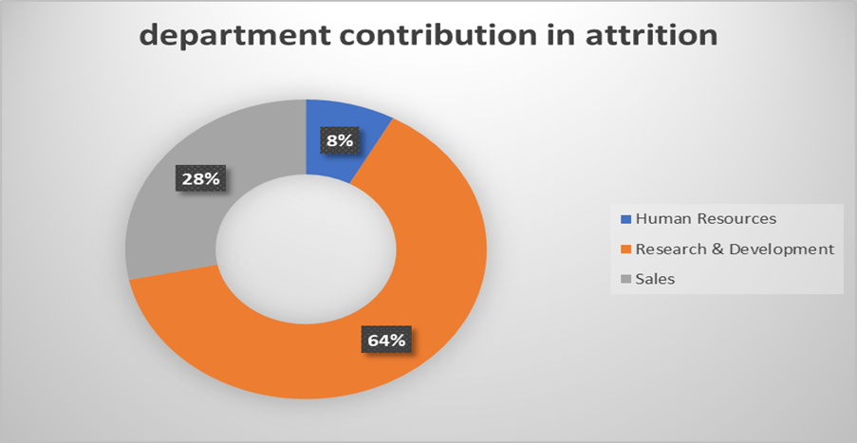
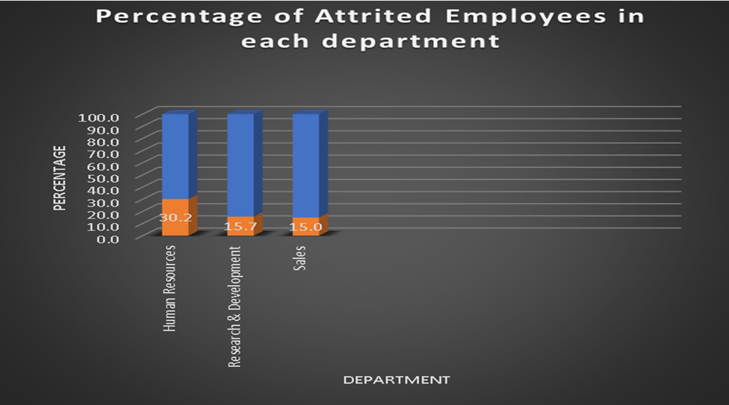
Project analysis slide 5
IBM HR Analysis
Department with Attrition

Slide 16
Project analysis slide 5
IBM HR Analysis
Department with Attrition
Observation:
Employees in HR department are more likely to quit while employees in Sales and R&D
departments are more likely to stay.
Company can compare those departments work structure and environment with checking HR department to
find the reasons behind that with a trial to mock strength points from R&D and Sales departments to the HR department.

Slide 17
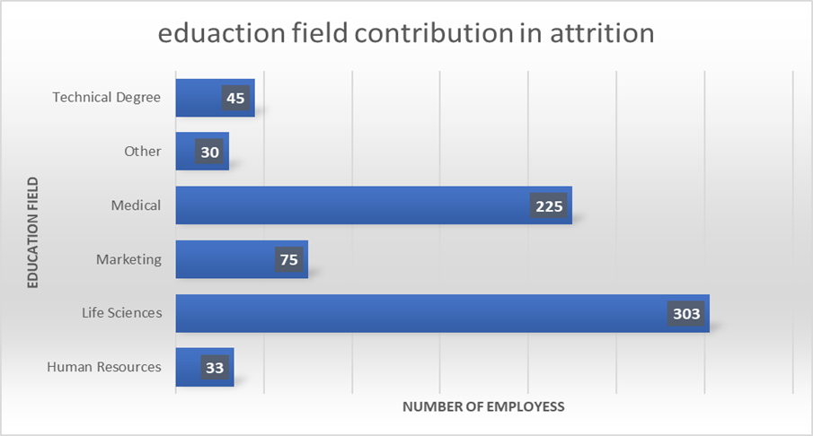
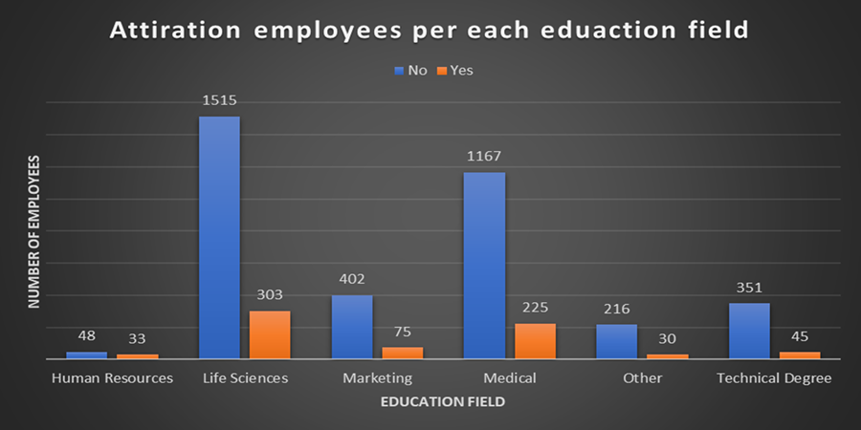
Project analysis slide 5
IBM HR Analysis
Education Field with Attrition

Slide 18
Project analysis slide 5
IBM HR Analysis
Education Field with Attrition
Observation:
Employees with HR and Technical Degree education fields are more likely to quit.

Slide 19
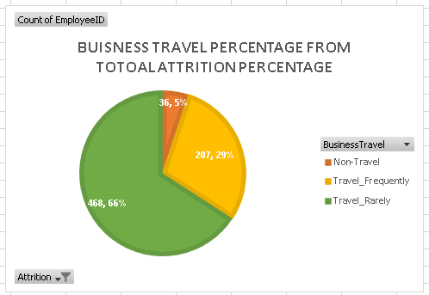
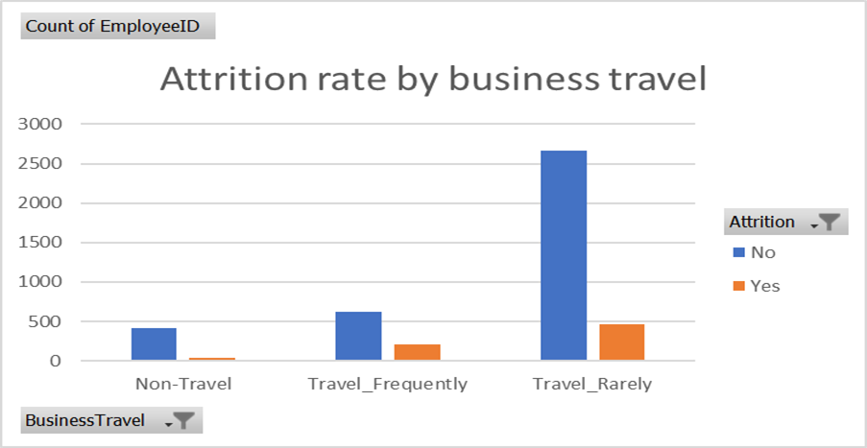
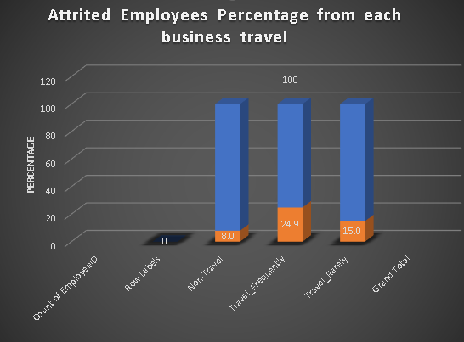
Project analysis slide 5
IBM HR Analysis
Business Travel with Attrition

Slide 20
Project analysis slide 5
IBM HR Analysis
Business Travel with Attrition
Observation:
Employees who travel frequently are more likely to quit.
Company should make sure that the travel is worth it and add value for employees
with proper satisfying travel compensations.

Slide 21
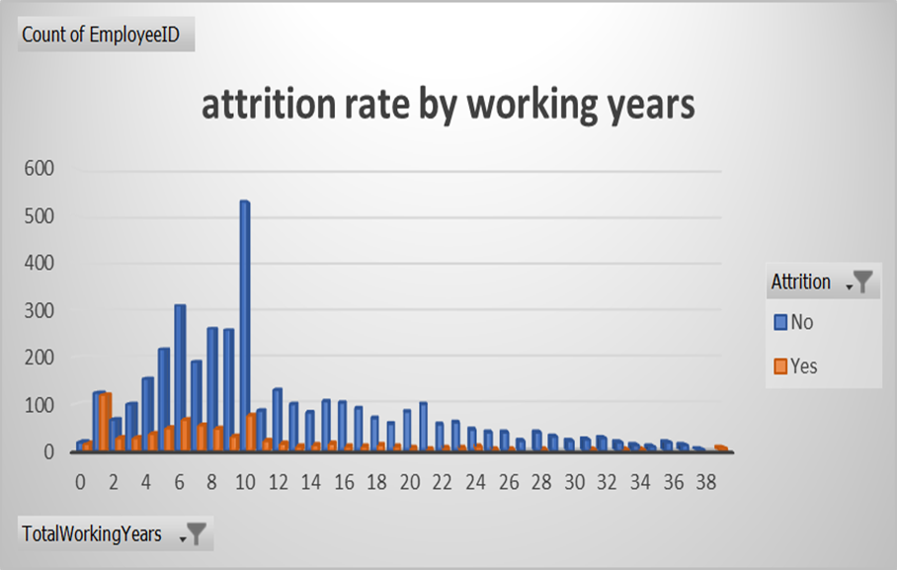
Project analysis slide 5
IBM HR Analysis
Total Working Years with Attrition
(78% of employees are with
1 to 11 working years)

Slide 22
Project analysis slide 5
IBM HR Analysis
Total Working Years with Attrition
Observation:
Employees with lower total working years are more likely to quit
Does company should increase juniors learning curve, trainings and involvement?

Slide 23
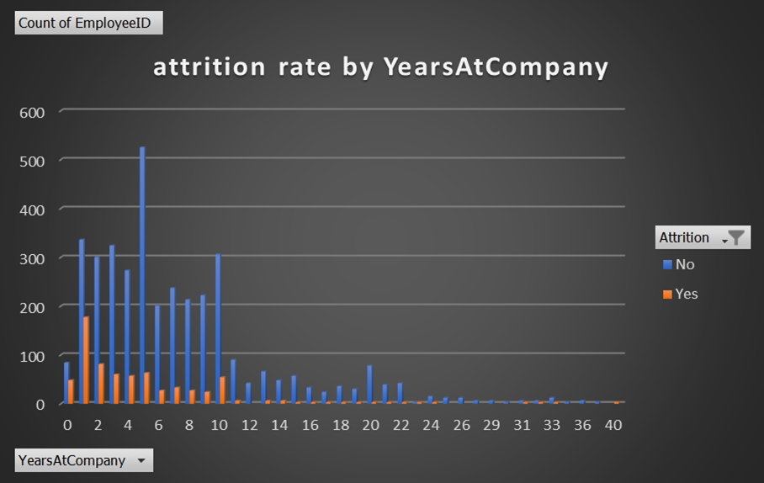
Project analysis slide 5
IBM HR Analysis
Years at Company with Attrition
92% of employees are with
0 to 10 years at company

Slide 24
Project analysis slide 5
IBM HR Analysis
Total Working Years with Attrition
Observation:
Employees with lower working years at company are more likely to quit
More Involvement and care for the new comers employees can help.

Slide 25
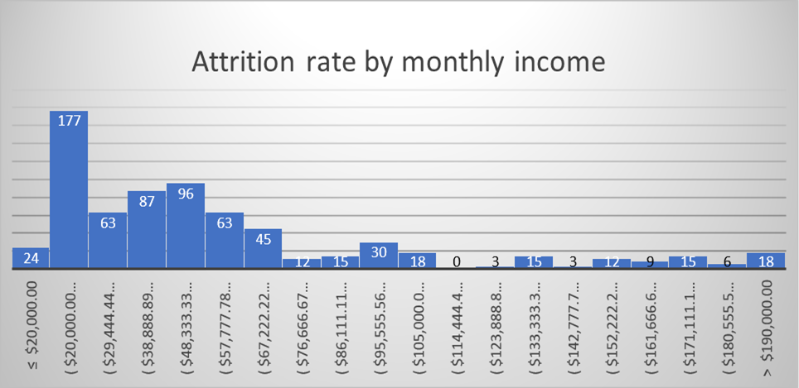
Project analysis slide 5
IBM HR Analysis
Monthly Income with Attrition

Slide 26
Project analysis slide 5
IBM HR Analysis
Monthly Income with Attrition
Observation:
Employees with lower monthly income are more likely to quit.

Slide 27
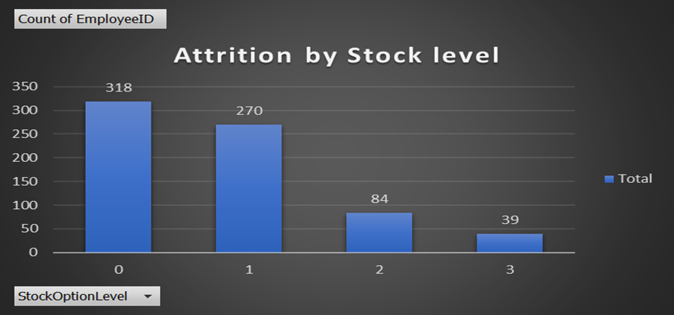
Project analysis slide 5
IBM HR Analysis
Stock Level with Attrition

Slide 28
Project analysis slide 5
IBM HR Analysis
Stock Level with Attrition
Observation:
Employees with lower stock level are more likely to quit.

Slide 29
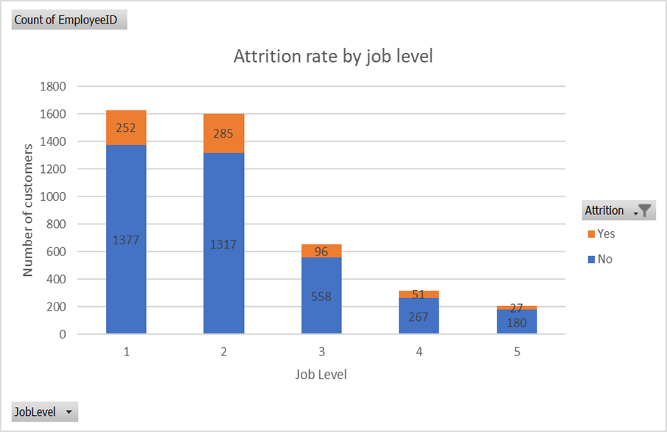
Project analysis slide 5
IBM HR Analysis
Job Level with Attrition

Slide 30
Project analysis slide 5
IBM HR Analysis
Job Level with Attrition
Observation:
Employees with lower job level are more likely to quit.

Slide 31
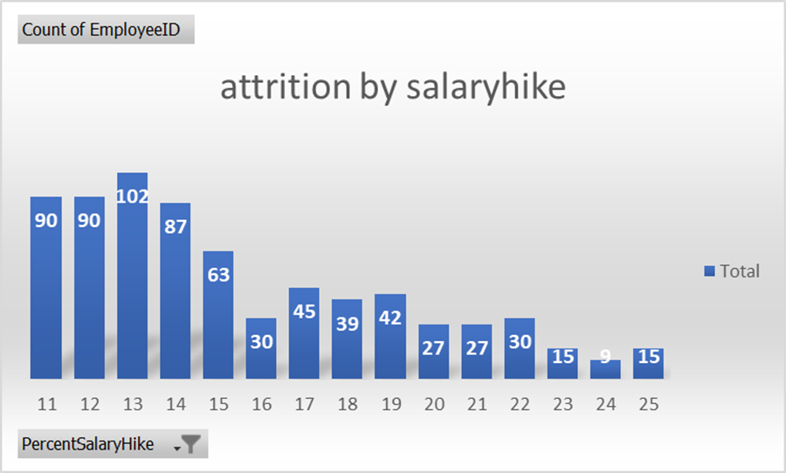
Project analysis slide 5
IBM HR Analysis
Salary Hike with Attrition

Slide 32
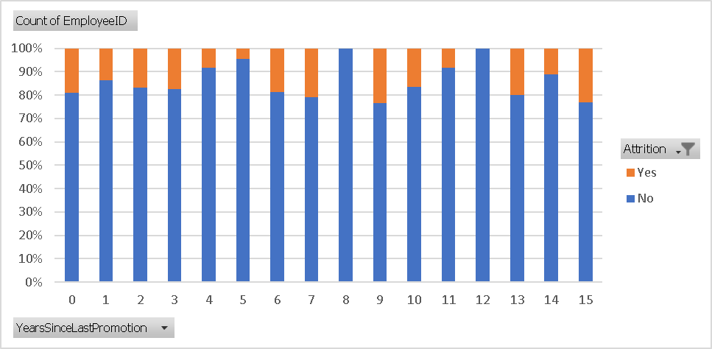
Project analysis slide 5
IBM HR Analysis
Years since last promotion with Attrition

Slide 33
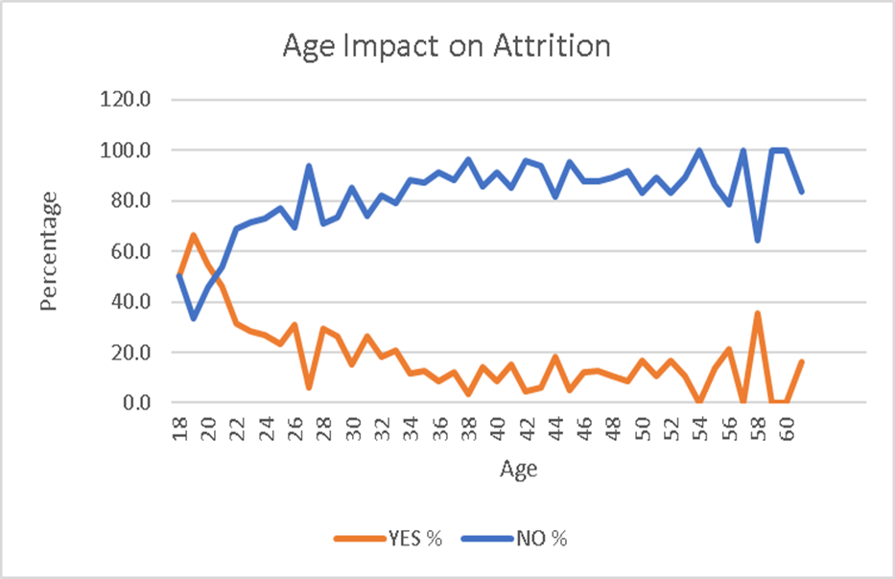
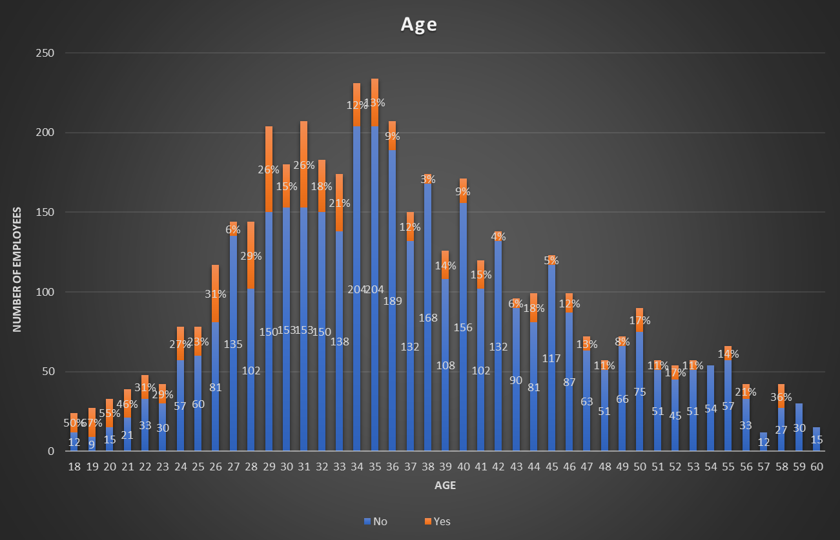
Project analysis slide 5
IBM HR Analysis
Age with Attrition

Slide 34
Project analysis slide 5
IBM HR Analysis
Age with Attrition
Observation:
Employees with lower age ranges from 18 till 26 are more likely to quit.
To repeat, More Involvement and trainings plan and satisfied environment for
the juniors and new comers may help.

Slide 35
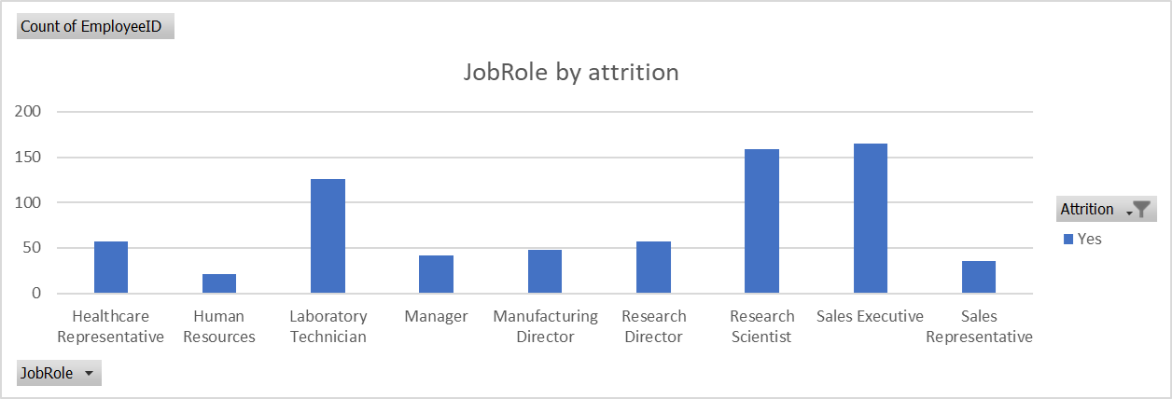
Project analysis slide 5
IBM HR Analysis
Job Role with Attrition

Slide 36
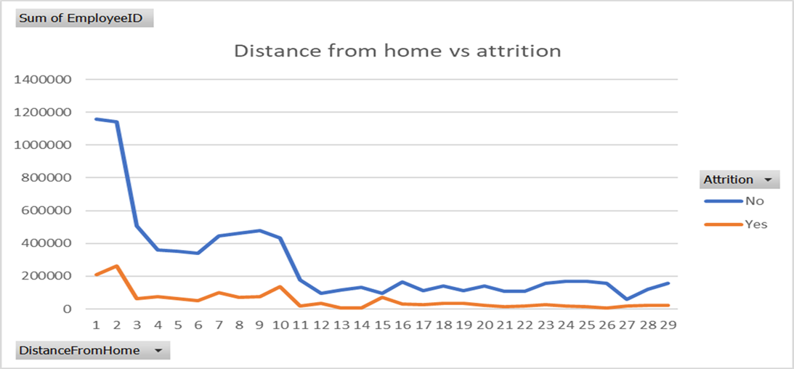
Project analysis slide 5
IBM HR Analysis
Distance from home with Attrition

Slide 37
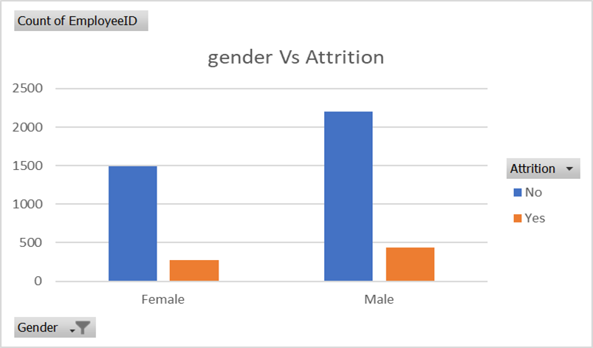
Project analysis slide 5
IBM HR Analysis
Gender with Attrition

Slide 38
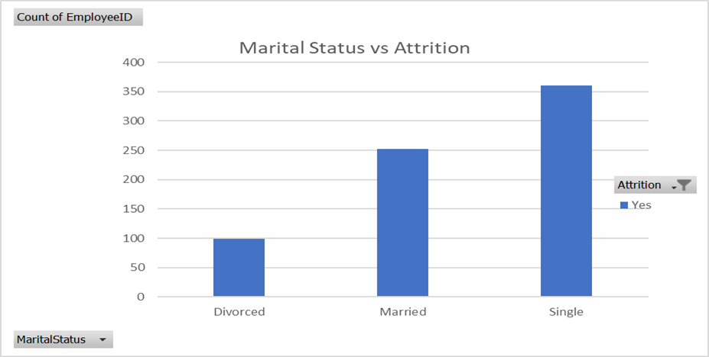
Project analysis slide 5
IBM HR Analysis
Marital Status with Attrition

Slide 39
Project analysis slide 5
IBM HR Analysis
Marital Status with Attrition
Observation:
Percentage of employees with single marital status and quit are higher than others
May they have less responsibilities than others so shifting for them is not as much risky,
May they seek more for work environment and learning curve than financial sources.

Slide 40
Project analysis slide 4
IBM HR Analysis
,
Low Income.
Single, Female, Low Income.
19%
32%
Single, Male, Low Income.
78%
Married, Female,
Low Income .
14%
Married, Male,
Low Income .
37%
63%
22%
Female ,
Low Income.
Male ,
Low Income.
Divorced, Female,
Low Income .
4%
9%
Divorced, Male,
Low Income .
Note: Low income relatively
From min(10,510) to 76,540
Where max is 199,990

Slide 41
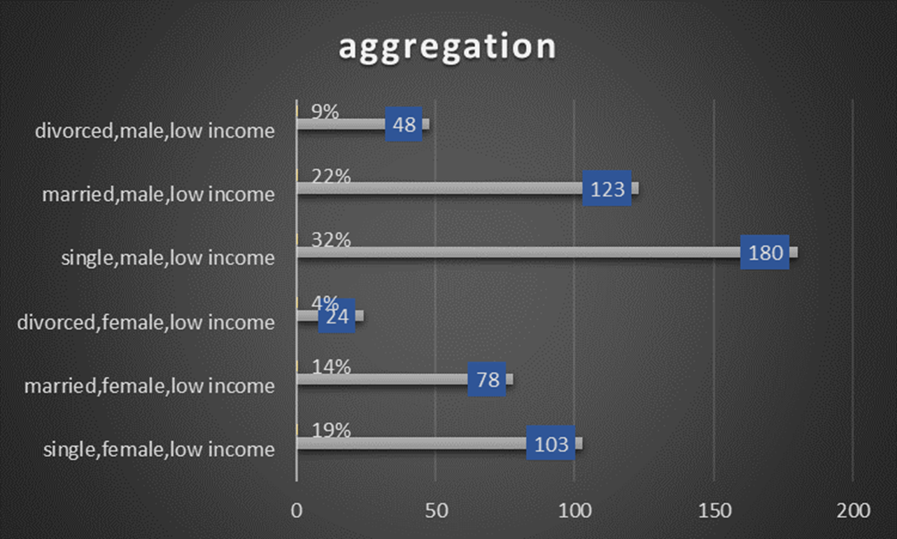
Project analysis slide 5
IBM HR Analysis

Slide 42
Project analysis slide 5
IBM HR Analysis
Conclusion and Insights found
Employees with lower age, job Level, Monthly Income, Year At Company, and Total Working Years are more likely to quit their jobs.
Employees who travel frequently are more likely to quit then other employees.
Employees in HR department are more likely to quit than works in sales and R&D departments.
Males are more likely to quit.
Employees in Laboratory Technician, Sales Representative, and Human Resources are more likely to quit the employees in other positions.
Employees who have Single marital status are more likely to quit than Married and Divorced.
Almost 40% from employees gave lower ranks for job and environment satisfaction.
On other side, managers are almost satisfied from employees job involvement and performance rate.
High percentage from employees working in job roles not related to their education level which can have a huge impact on attrition rates.

Slide 43
Project analysis slide 5
IBM HR Analysis
Considerations mostly help the company.
It’ll be better if company considered more the juniors and new comers job involvement, training plan,
increase learning curve, awards.
It’ll be better if company considered more the employees environment satisfaction, with more team building plans, which definitely will increase loyalty to company.
It’ll be better if company enhances it’s travel compensations for whom they travel frequently.
It’ll be better if company assigned dedicated employees in job roles related to their education level.
Total Employees quitted are 16%, hopefully to be decrease in the future with those insights & considerations

Slide 44
Project analysis slide 5
IBM HR Analysis
Observations related to dataset
Data is hugely Imbalanced, so analysis with percentages is way more reliable than analysis with numbers.
Data is almost understood and clean
Data contain very low null values and blanks in surveys , around only 70 records from total 4420 record.
Some features has zero effect on analysis as Standard hours , Over 18, Employee Count
Some features have better effect on analysis than others

Slide 45
Project analysis slide 8
Project Analysis
POSITIVE
NEGATIVE
STRENGTH
WEAKNESS
INTERNAL
Qualified, Reliable, Hard workers Employees with high job involvement and performance rates.
Less comfortable work environment
Low learning curve for employees
OPPORTUNITY
THREAT
EXTERNAL
Not effectively has ability to involve the fresh heads and juniors and satisfy their non financial needs
Having calibers that I can get better use of them.

Slide 46
Project analysis slide 5
IBM HR Analysis
References
-Data
General data
https://docs.google.com/spreadsheets/d/1ApJ3mzsQHgCJ0e2hGmmFBd-opkJSx9AS/edit?usp=sharing&ouid=102421511137394077628&rtpof=true&sd=true
Employees Survey
https://drive.google.com/file/d/148fnkGT3RJvGApNgXSBGnbZ29OfPpRbE/view?usp=sharing
Managers Survey
https://drive.google.com/file/d/1pTLrZTuBsg6MHpg4DFHhyW3lG8GHgHlO/view?usp=sharing
Data Dictionary
https://docs.google.com/spreadsheets/d/170v9iVXAtJ5Zj9uDfb9twWBu-xGbrKH4/edit?usp=sharing&ouid=102421511137394077628&rtpof=true&sd=true
And finally:
Analysis
https://docs.google.com/spreadsheets/d/1X4lifwXVBxiXfw2Vh4gzJgf-7jEFvbkA/edit?usp=sharing&ouid=102421511137394077628&rtpof=true&sd=true
Note: All the analysis and visualzations is done only by using Microsoft Excel.

Slide 47
Thank You

